Slide 1
Example: 3
The probability that a student passes in statistics examination is 2/3 and the probability that he /she will not pass in mathematics examination is 5/9. The probability that he/she will pass in at least one of the examination is 4/5. Find the probability that he /she will pass in both the examinations

Slide 2
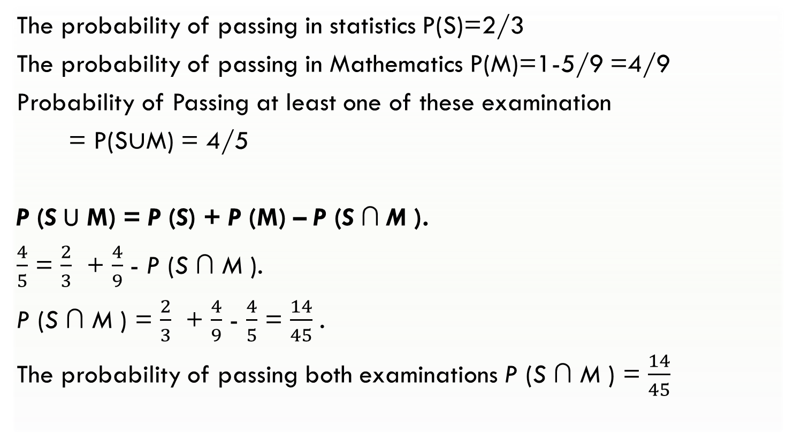
Solution:
The probability of passing in statistics P(S)=2/3
The probability of passing in Mathematics P(M)=1-5/9 =4/9
Probability of Passing at least one of these examination
= P(S$∪$M) = 4/5
P (S U M) = P (S) + P (M) – P (S ∩ M ).
$\frac{4}{5}$ = $\frac{2}{3}$ + $\frac{4}{9}$ - P (S ∩ M ).
P (S ∩ M ) = $\frac{2}{3}$ + $\frac{4}{9}$ - $\frac{4}{5}$ = $\frac{14}{45}$ .
The probability of passing both examinations P (S ∩ M ) = $\frac{14}{45}$

Slide 3
Example: 4
Suppose that 75% of all investors invest in traditional annuities and 45% of them invest in the stock market. If 85% invest in the stock market and/or traditional annuities, what percentage invest in both?

Slide 4
Solution:
Let A be the event that a randomly selected investor invests in traditional annuities.
Let B be the event that he or she invests in the stock market.
Then P (A) = 0.75, P (B) = 0.45, and P (A ∪ B) = 0.85
Since,
P (AB) = P (A) + P (B) − P (A ∪ B)
= 0.75 + 0.45 − 0.85
= 0.35.

Slide 5
Example: 5
Suppose the manufacturer’s specifications for the length of a certain type of computer cable are 2000 ± 10 millimeters. In this industry, it is known that small cable is just as likely to be defective (not meeting specifications) as large cable. That is, the probability of randomly producing a cable with length exceeding 2010 millimeters is equal to the probability of producing a cable with length smaller than 1990 millimeters. The probability that the production procedure meets specifications is known to be 0.99.
What is the probability that a cable selected randomly is too large?
(b) What is the probability that a randomly selected cable is larger than 1990 millimeters?

Slide 6
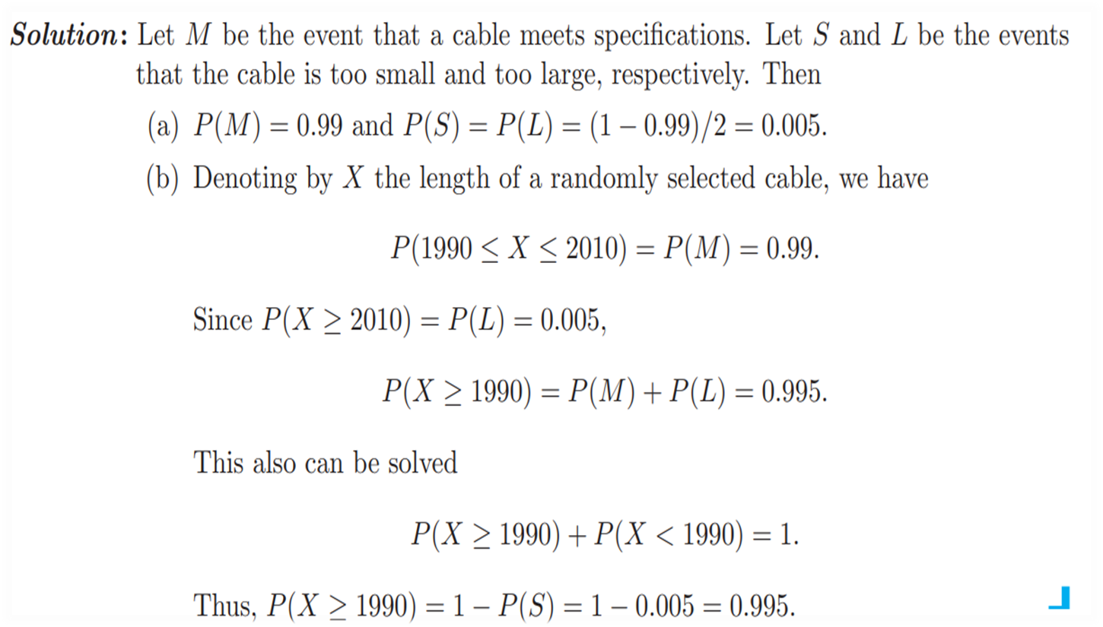

Slide 7

Example: 6
Let S be a sample space and A and B are two mutually exclusive events such that AUB = S. If P(.) denotes the probability of the event, then what is the maximum value of P(A).P(B)?
Solution:
So P(A) = P(B) = ½
Hence P(A).P(B) = 1/4

Slide 8
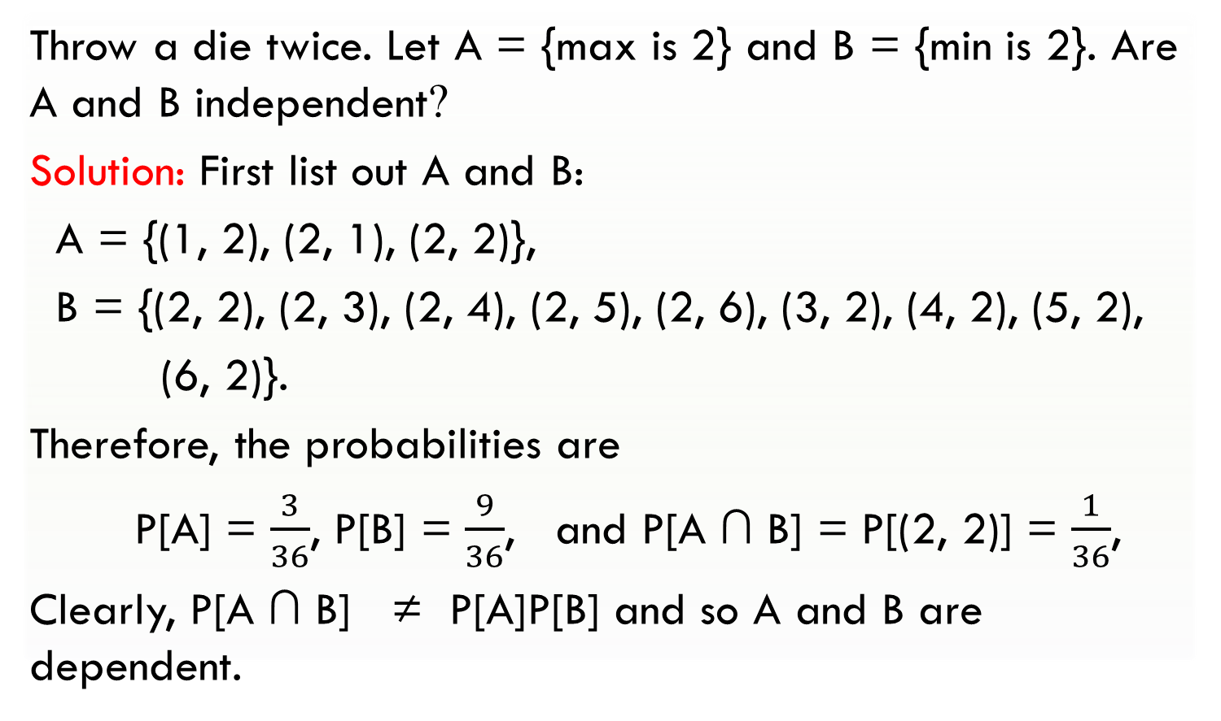
Example: 7
Throw a die twice. Let A = {max is 2} and B = {min is 2}. Are A and B independent?
Solution: First list out A and B:
A = {(1, 2), (2, 1), (2, 2)},
B = {(2, 2), (2, 3), (2, 4), (2, 5), (2, 6), (3, 2), (4, 2), (5, 2),
(6, 2)}.
Therefore, the probabilities are
P[A] = $\frac{3}{36}$, P[B] = $\frac{9}{36}$, and P[A ∩ B] = P[(2, 2)] = $\frac{1}{36}$,
Clearly, P[A ∩ B] ≠ P[A]P[B] and so A and B are dependent.

Slide 9
Example: 8
The computers of six faculty members in a certain department are to be replaced. Two of the faculty members have selected laptop machines and the other four have chosen desktop machines. Suppose that only two of the setups can be done on a particular day, and the two computers to be set up are randomly selected from the six
(implying 15 equally likely outcomes; if the computers are numbered 1, 2, . . . , 6, then one outcome consists of computers 1 and 2, another consists of computers 1 and 3, and so on).
[(1,2),(1,3), (1,4), (1,5), (1,6),(2,3), (2,4), (2,5), (2,6),(3,4), (3,5), (3,6), (4,5), (4,6), (5,6)]

Slide 10
Example: 8
[(1,2),(1,3), (1,4), (1,5), (1,6),(2,3), (2,4), (2,5), (2,6),(3,4), (3,5), (3,6), (4,5), (4,6), (5,6)]
a. What is the probability that both selected setups are for laptop computers?
b. What is the probability that both selected setups are desktop machines?
c. What is the probability that at least one selected setup is for a desktop computer?
d. What is the probability that at least one computer of each type is chosen for setup?

Slide 11
Solution:
In the exercise, it is described that the computers are numbered from one to six, and that the first two (computer 1 and computer 2) are the laptops. All possible outcomes are
[(1,2),(1,3), (1,4), (1,5), (1,6),(2,3), (2,4), (2,5), (2,6),(3,4), (3,5), (3,6), (4,5), (4,6), (5,6)]
because we select only two computers out of six, randomly.
All the outcomes have the same probability which is 1/15.
(we have 15 outcomes).

Slide 12
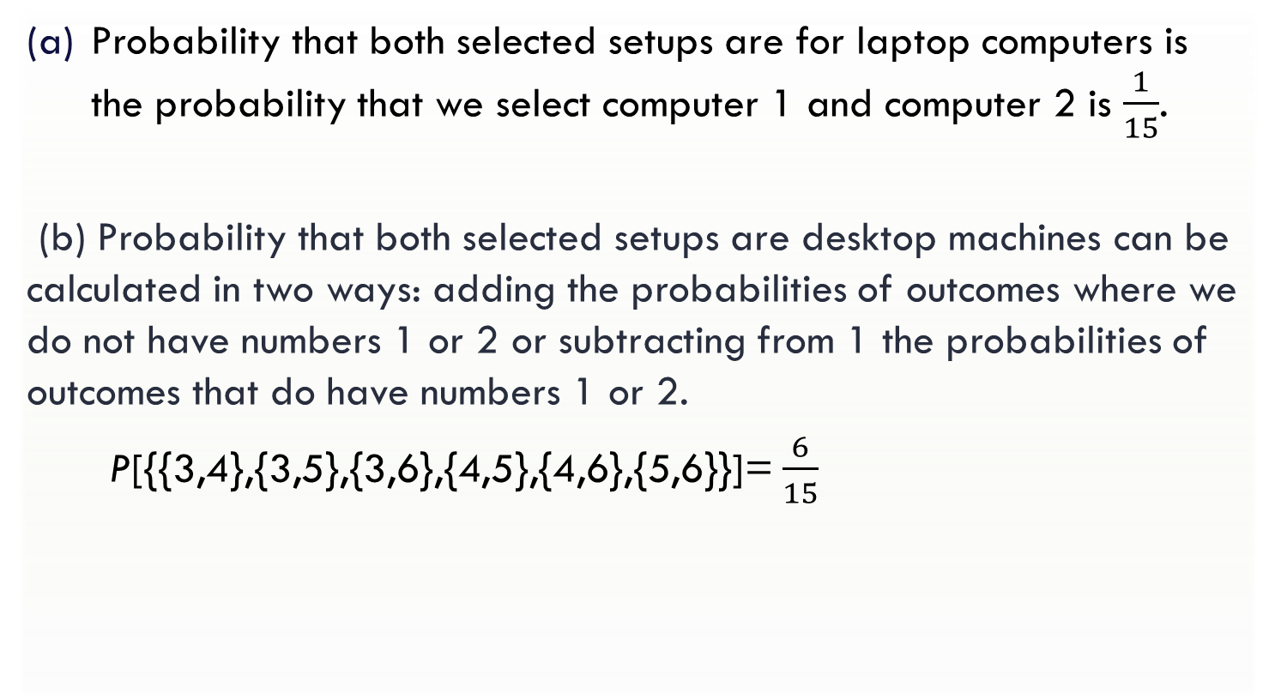
Contd..
[(1,2),(1,3), (1,4), (1,5), (1,6),(2,3), (2,4), (2,5), (2,6),(3,4), (3,5), (3,6), (4,5), (4,6), (5,6)]
Probability that both selected setups are for laptop computers is the probability that we select computer 1 and computer 2 is $\frac{1}{15}$.
(b) Probability that both selected setups are desktop machines can be calculated in two ways: adding the probabilities of outcomes where we do not have numbers 1 or 2 or subtracting from 1 the probabilities of outcomes that do have numbers 1 or 2.
P[{{3,4},{3,5},{3,6},{4,5},{4,6},{5,6}}]= $\frac{6}{15}$

Slide 13
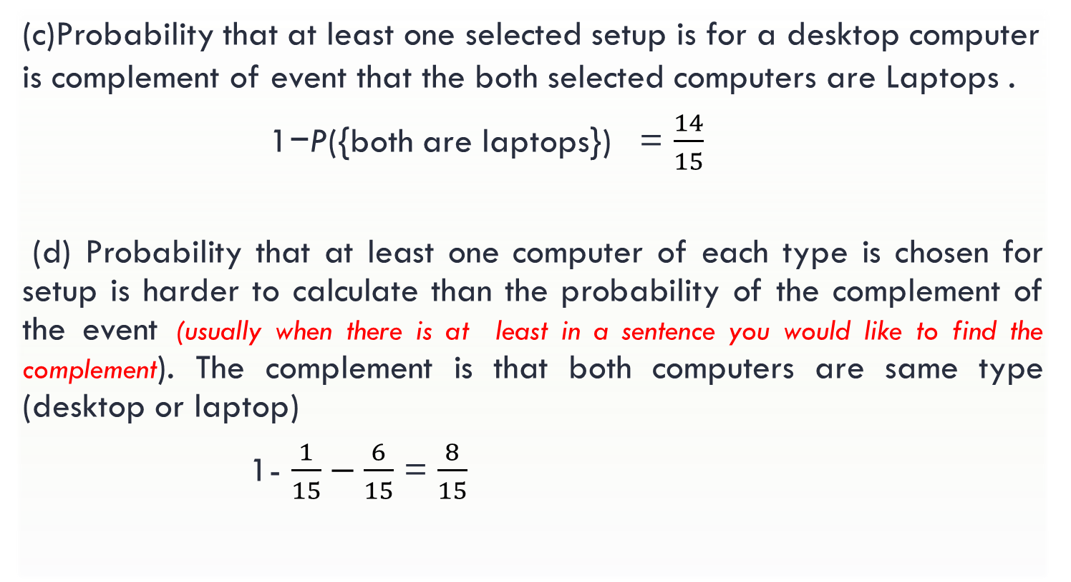
Contd..
[(1,2),(1,3), (1,4), (1,5), (1,6),(2,3), (2,4), (2,5), (2,6),(3,4), (3,5), (3,6), (4,5), (4,6), (5,6)]
(c)Probability that at least one selected setup is for a desktop computer is complement of event that the both selected computers are Laptops .
1−P({both are laptops}) = $\frac{14}{15}$
(d) Probability that at least one computer of each type is chosen for setup is harder to calculate than the probability of the complement of the event (usually when there is at least in a sentence you would like to find the complement). The complement is that both computers are same type (desktop or laptop)
1- $\frac{1}{15}−\frac{6}{15}$ = $\frac{8}{15}$

Slide 14
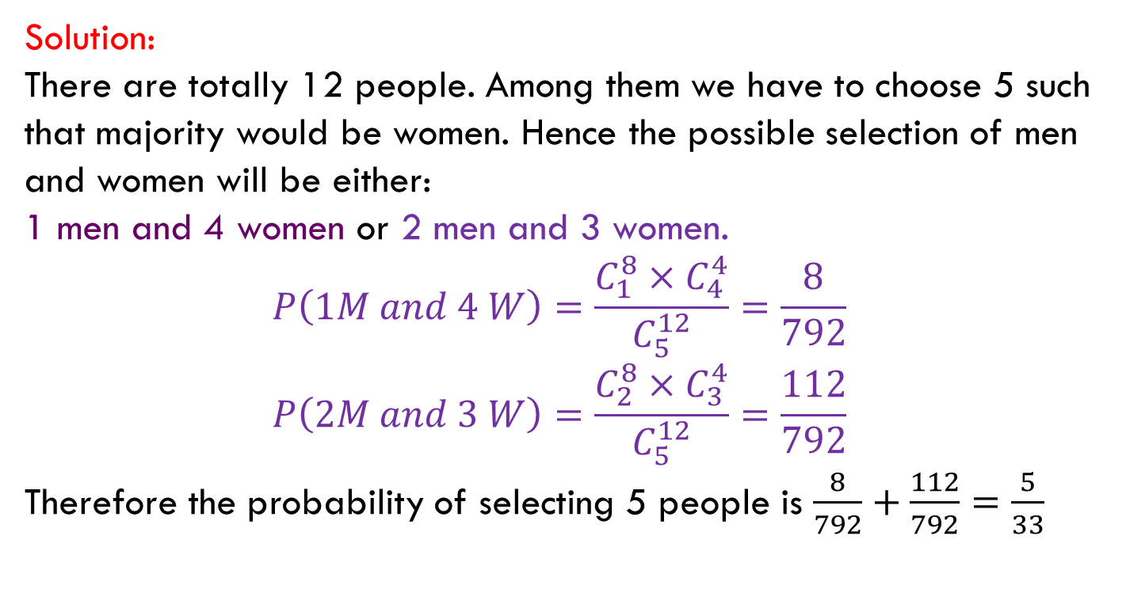
Example: 9
A committee of 5 is chosen from a group of 8 men and 4 women. What is the probability that the group contains a majority of women?
Solution:
There are totally 12 people. Among them we have to choose 5 such that majority would be women. Hence the possible selection of men and women will be either:
1 men and 4 women or 2 men and 3 women.
$$P\left(1M and 4 W\right)=\frac{C_{1}^{8}×C_{4}^{4}}{C_{5}^{12}}=\frac{8}{792}$$
$$P\left(2M and 3 W\right)=\frac{C_{2}^{8}×C_{3}^{4}}{C_{5}^{12}}=\frac{112}{792}$$
Therefore the probability of selecting 5 people is $\frac{8}{792}+\frac{112}{792}=\frac{5}{33}$

Slide 15
Practice problems
(Home work)

Slide 16
Practice problems:
Q1: A Survey conducted by a bank revealed that 40% of the accounts are savings accounts and 35% of the accounts are current accounts and the balance are loan accounts.
What is the probability that an account taken at random is a loan account ? Ans: 0.25
What is the probability that an account taken at random is NOT savings account ? Ans: 0.60
What is the probability that an account taken at random is NOT a current account ? Ans: 0.65
What is the probability that an account taken at random is a current account or a loan account? Ans: 0.60

Slide 17
Practice problems:
Q2. A speaks truth in 80% cases and B speaks in 60% cases. What percentage of cases are they likely to contradict each other in stating the same fact.
Hint / Ans: P(Contradiction)=P(A truth and B false)+P(A false and B truth)=0.32+0.12=0.44
Q3. In a certain residential suburb, 60% of all households get Internet service from the local cable company, 80% get television service from that company, and 50% get both services from that company. If a household is randomly selected,
What is the probability that it gets at least one of these two services from the company?
Ans: P(Internet or Television)=0.90
ii) What is the probability that it gets exactly one of these services from the company?
Ans: P(Exactly one service)=P(Internet but not Television)+P(Television but not Internet)=0.10+0.30=0.40

Slide 18
Practice problems:
Q4: The next generation of miniaturised wireless capsules with active locomotion will require two miniature electric motors to manoeuvre each capsule. Suppose 10 motors have been fabricated but that, in spite of test performed on the individual motors 2 will not operate satisfactorily when placed into capsule, to fabricate a new capsule,2 motors will be randomly selected(that is, each pair of motors has the same chance of being selected ) find the probability that
Both motors will operate satisfactorily in the capsule.
One motor will operate satisfactorily and other will not.

Slide 19
Practice problems:
Q5. Suppose that 55% of all adults regularly consume coffee, 45% regularly consume carbonated soda, and 70% regularly consume at least one of these two products.
i) What is the probability that a randomly selected adult regularly consumes both coffee and soda?
ii) What is the probability that a randomly selected adult doesn’t regularly consume at least one of these two products?

Slide 20
Practice problems:
Q6. Suppose a student is selected at random from 80 students where 30 are taking mathematics, 20 are taking chemistry and 10 are taking both. Find the probability ‘p’ that the student is taking Mathematics or chemistry?.
Q 7: If A and B are events with P(A U B) = 7/8,
P(A ∩ B) = ¼ and P(A') = 5/8, find P(A), P(B) and P(A ∩ B').

Slide 21
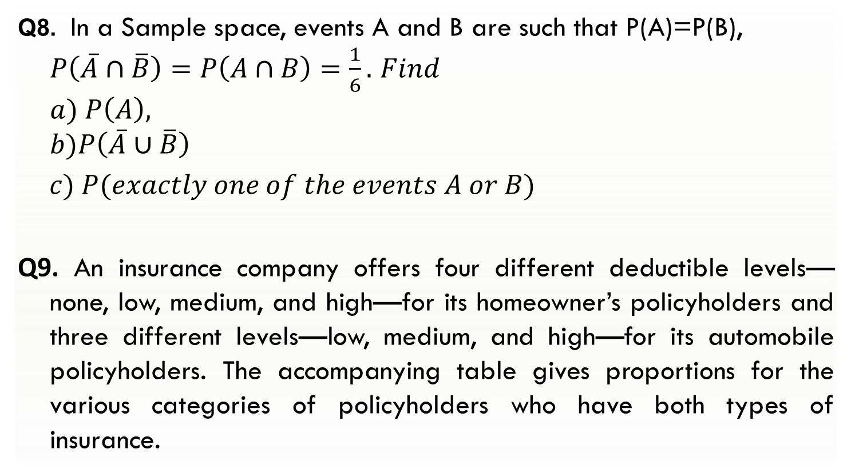
Practice problems:
Q8. In a Sample space, events A and B are such that P(A)=P(B), $P\left(\overline{A}∩\overline{B}\right)=P\left(A∩B\right)=\frac{1}{6}.$ $Find$
$$a) P\left(A\right),$$
$$b)P\left(\overline{A}∪\overline{B}\right)$$
$c) P(exactly one of the events A or B)$
Q9. An insurance company offers four different deductible levels—none, low, medium, and high—for its homeowner’s policyholders and three different levels—low, medium, and high—for its automobile policyholders. The accompanying table gives proportions for the various categories of policyholders who have both types of insurance.

Slide 22
Practice problems:
For example, the proportion of individuals with both low homeowner’s deductible and low auto deductible is .06 (6% of all such individuals.
Homeowner’s
Auto | N | L | M | H
L | 0.04 | 0.06 | 0.05 | 0.03
M | 0.07 | 0.10 | 0.20 | 0.10
H | 0.02 | 0.03 | 0.15 | 0.1

Slide 23
Suppose an individual having both types of policies is randomly selected.
a. What is the probability that the individual has a medium auto deductible and a high homeowner’s deductible?
b. What is the probability that the individual has a low auto deductible? A low homeowner’s deductible?
c. What is the probability that the individual is in the same category for both auto and homeowner’s deductibles?
d. Based on your answer in part (c), what is the probability that the two categories are different?
e. What is the probability that the individual has at least one low deductible level ?
f. Using the answer in part (e), what is the probability that neither deductible level is low ?

Slide 24
Glossary
Random experiment- an experiment whose outcome is uncertain before performing it.
Sample space-set of all possible outcomes of an experiment.
Event- outcome of an experiment.
Equally Likely Outcomes – Outcomes which are having same probability
Mutually exclusive events-events that do not occur at the same time.
Independent events- the events which occur freely of each other.
Operations on events
Union of events and its probability
Intersection of events and its probability
Complement of an event and its probability

Slide 25

IMP Note to Self

Slide 26
Thank you

